Slide 1
CS250 Lecture 37 – Buses
2017.11.15 In the early days we didn't have the bus, we had a station wagon. – Mel Tillis Country music singer and songwriter

Slide 2
Announcements
Lab08 myprintf( )
Raspbian gcc seems to insist that the integer -2147483648 cannot be represented using 32 bits, and so, uses 64 bits and then makes all arguments for calls to myprintf( ) occupy 64 bits in the stack
If you special-case coded to handle this integer, OK
I am adjusting the code test to exclude this integer
There is also a newline/carriage-return difference between your likely output and the testout file: diff will “complain bitterly” but you should not ignore your eyes this time: If it looks OK, it is OK

Slide 3
Announcements
No office hours Monday, Nov. 20, 4:30-5:30pm
For those on campus Monday, Nov. 20 Optional lecture about breaking the Enigma code in World War II by Alan Turing and team at Bletchley Park
Same time and place as our usual lecture
You and your guest(s) are invited

Slide 4
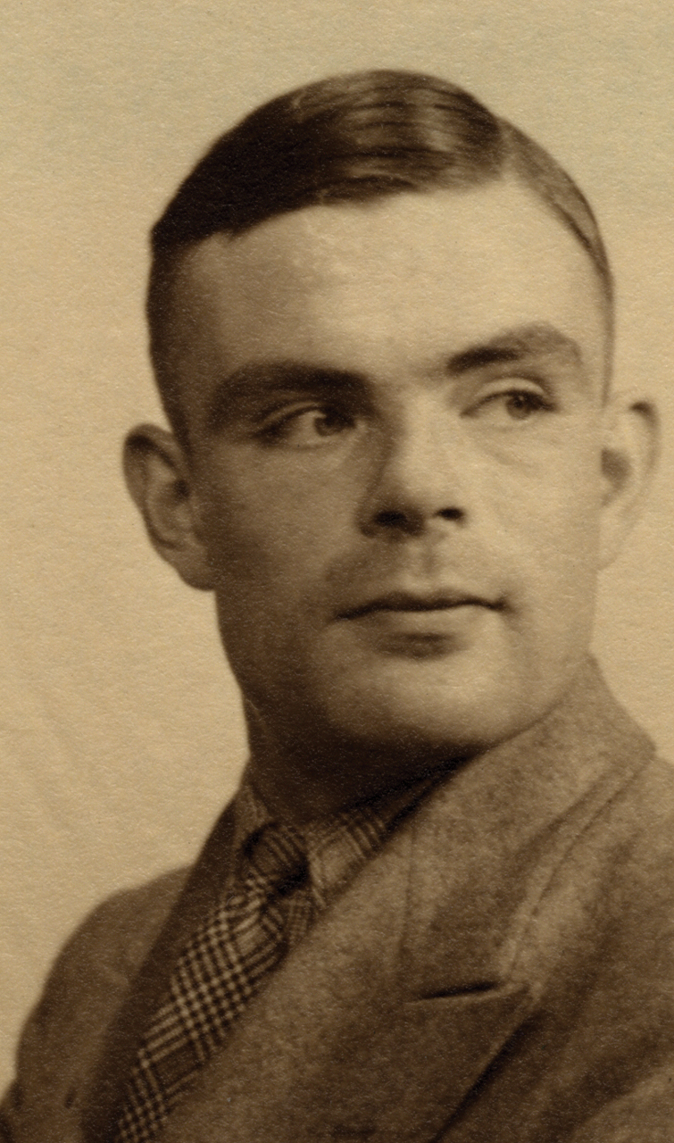
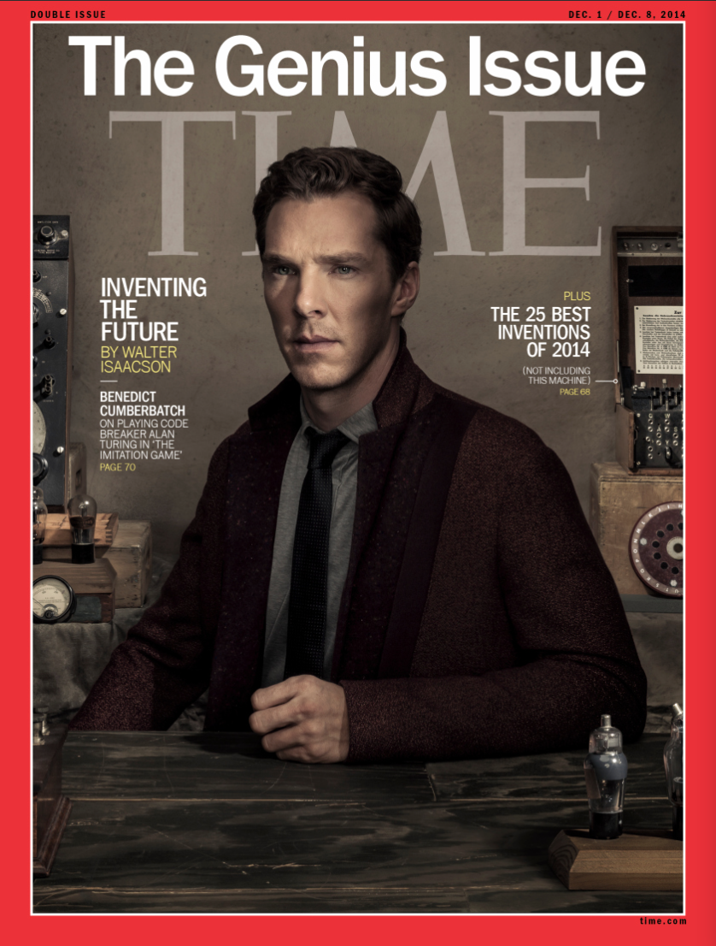
Alan Turing

Slide 14
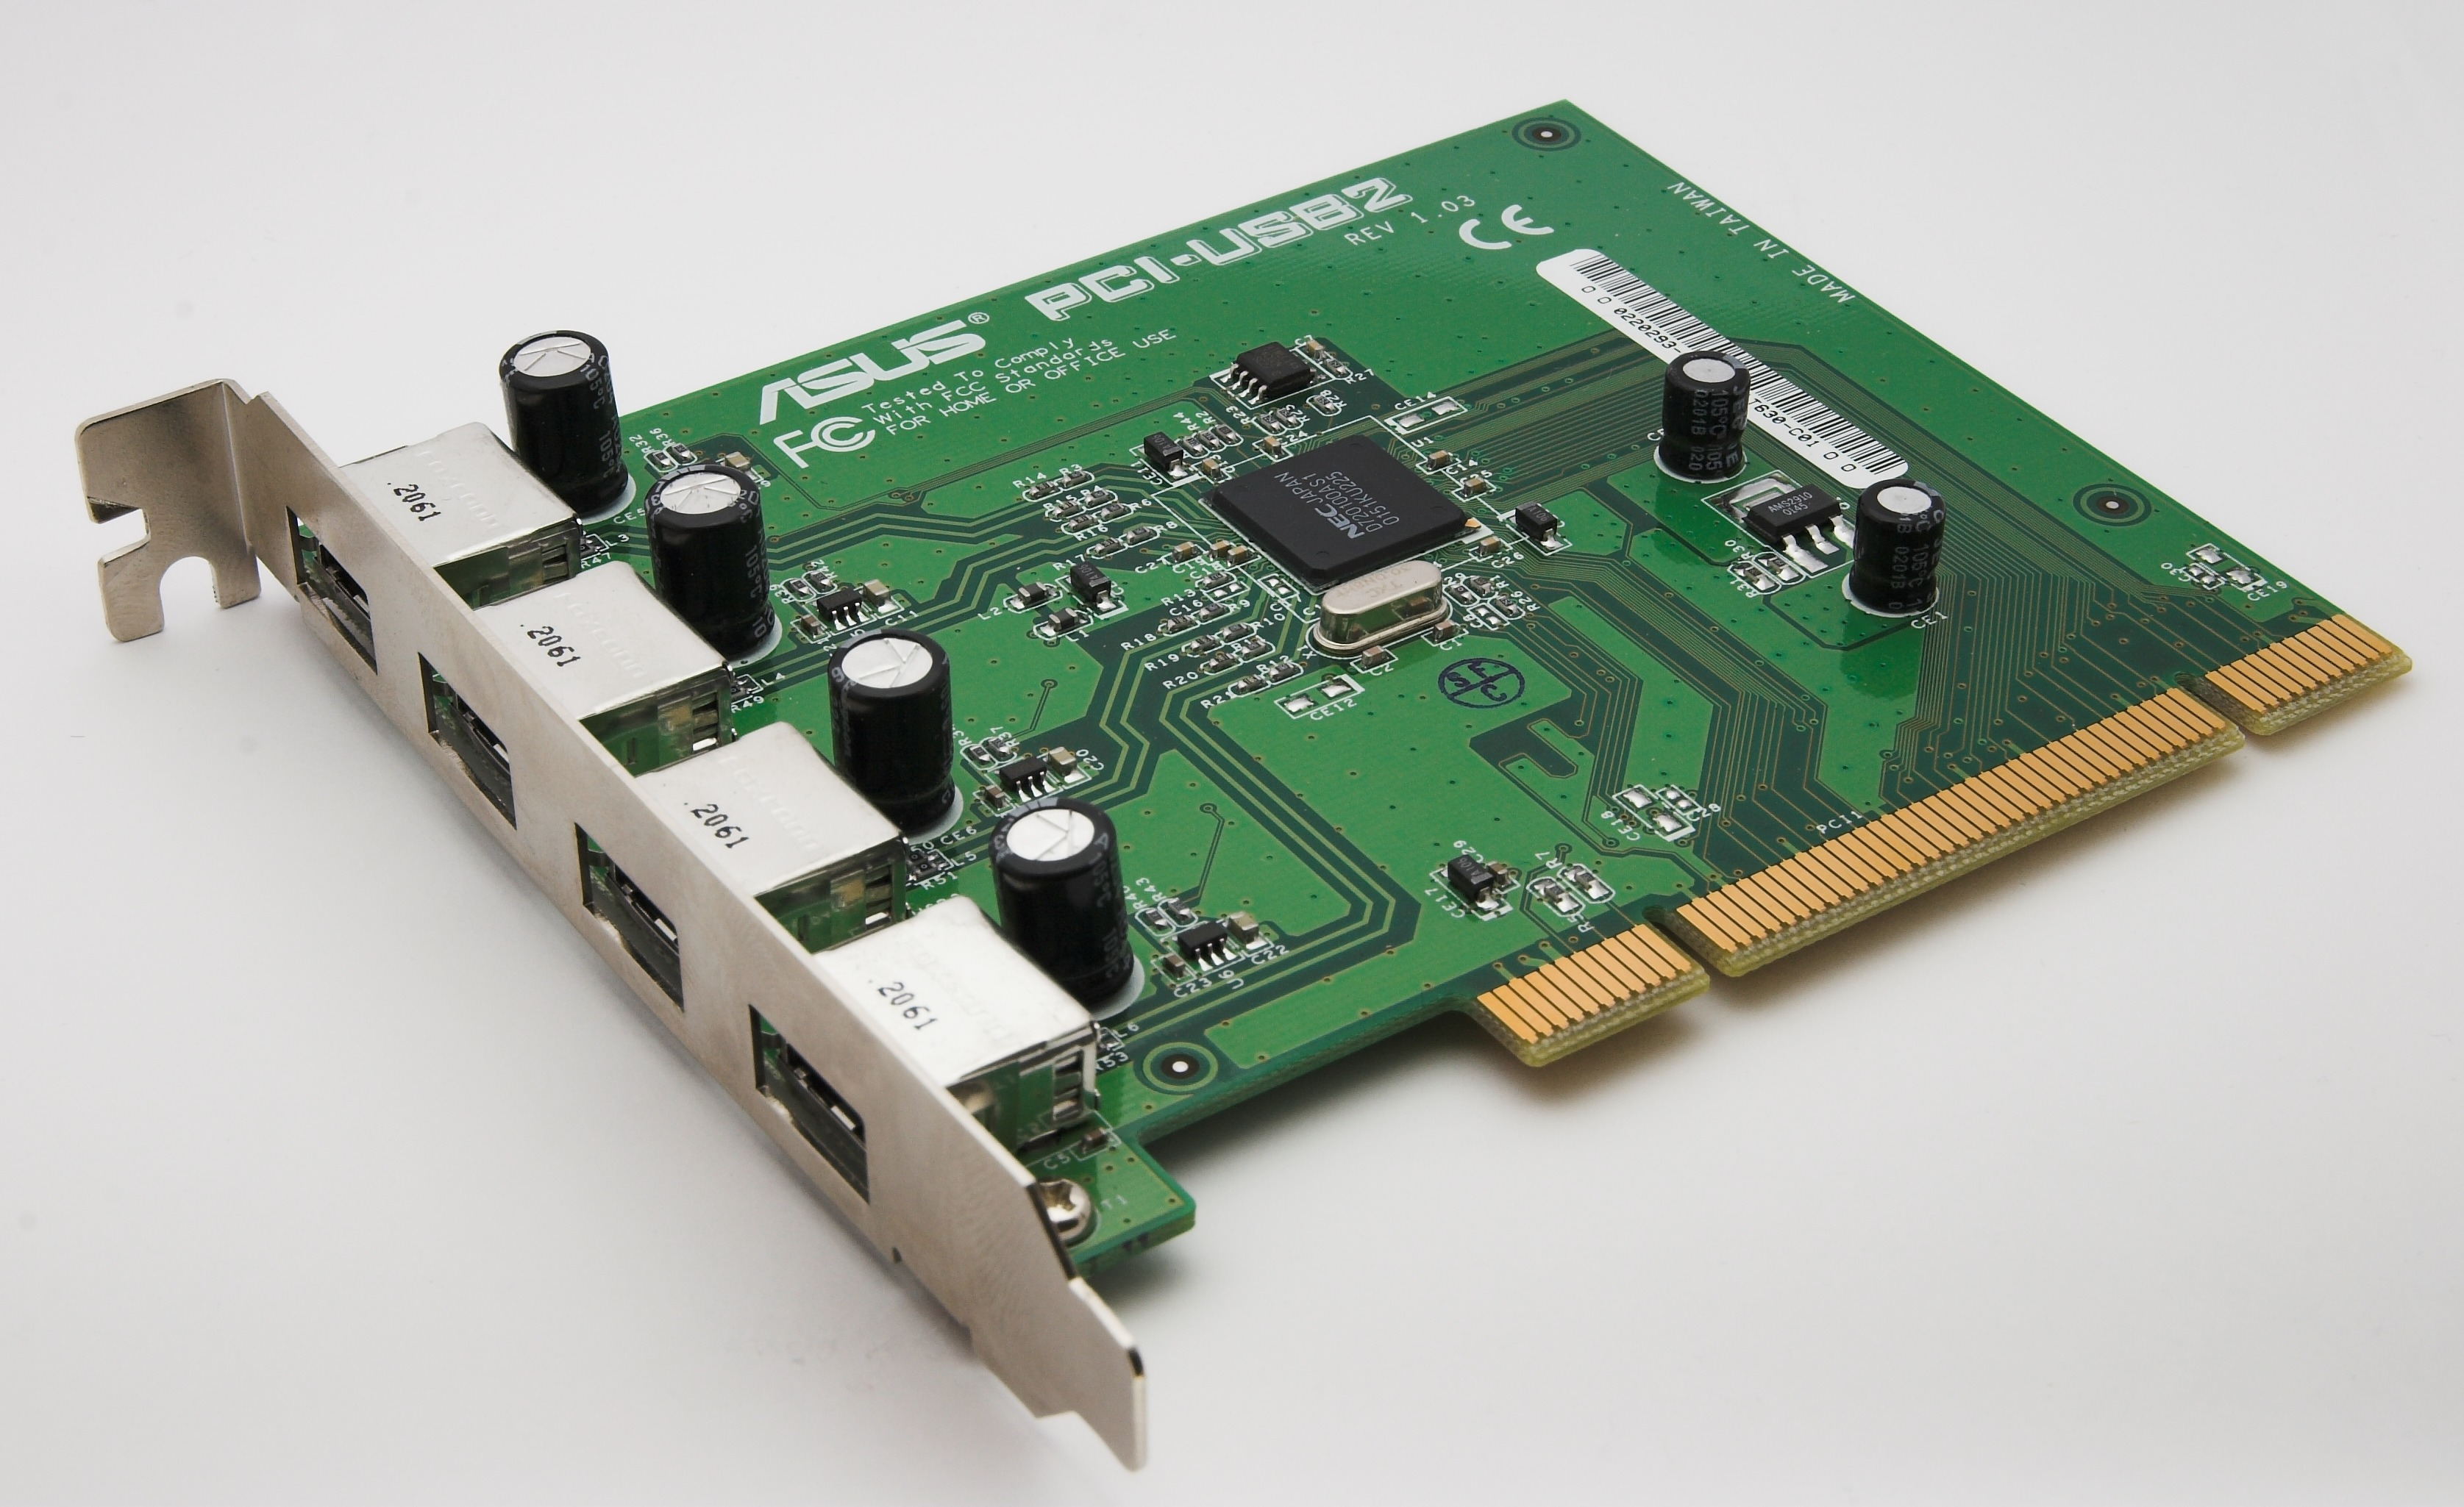

Slide 18
Information flows to fetching device
Information flows from storing device

Slide 20
and crosstalk
but reduced crosstalk

Slide 24
Configure then attach requires sys admin knowledge
Wiring approach = sys admin knowledge built in
Automatic is the third option above, very convenient, but
becomes an interface with the Real WorldTM with significant implications for computer security

Slide 34
typically

Slide 39
Connections created and deleted dynamically by action
of “Input” devices

